Slide 1
State Pattern
Notes:
Hi all this week we will talk to you about the state pattern and showcase our application which was built using the state pattern

Slide 2
Presentation Agenda
STATE PATTERN THEORY | OUR APPLICATION | DEVELOPMENT PROCESS
Strategy Pattern State Pattern SOLID Analysis Advantages & Disadvantages Possible Use Cases | Concept of NPC Main Idea State Pattern Alternative Implementations (Testing) | Amazon Leadership Principles TCE Analysis Team Work
Notes:
Our presentation mainly consists of 3 parts in the first part we will talk about the state pattern in general
In the second part we will explain our project and make a demonstration of the project to the class
And lastly we will talk about the development process for this project alongside with amazon leadership principles

Slide 3
Presentation Agenda
STATE PATTERN THEORY | OUR APPLICATION | DEVELOPMENT PROCESS
Strategy Pattern State Pattern SOLID Analysis Advantages & Disadvantages Possible Use Cases | Concept of NPC Main Idea State Pattern Alternative Implementations (Testing) | Amazon Leadership Principles TCE Analysis Team Work
Notes:
So let me start with the state design pattern

Slide 4
Presentation Agenda
STATE PATTERN THEORY | OUR APPLICATION | DEVELOPMENT PROCESS
Strategy Pattern State Pattern SOLID Analysis Advantages & Disadvantages Possible Use Cases | Concept of NPC Main Idea State Pattern Alternative Implementations (Testing) | Amazon Leadership Principles TCE Analysis Team Work
Notes:
To motivate the structure of the state design pattern we will start with reviewing the strategy pattern

Slide 5
Thinking Back To Strategy Pattern Class
Notes:
So lets think back to the strategy pattern class

Slide 6
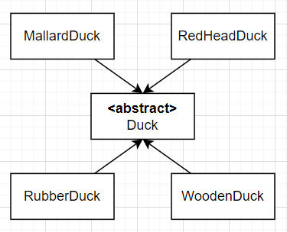
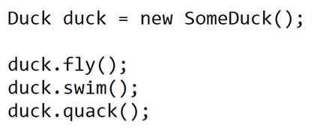
Duck Simulation Game: Setup
Want to build a duck simulation game
There might be different types of ducks
Ducks should be able to quack, fly and swim
Different ducks may quack and fly differently
Notes:
If you recall, in our first lecture we wanted built a duck simulation game
A requirement was that different ducks which derive from the abstract base duck class should be able to perform some actions such as quack fly and swim
But the ducks could quack and fly diffferenty based on their type.

Slide 7
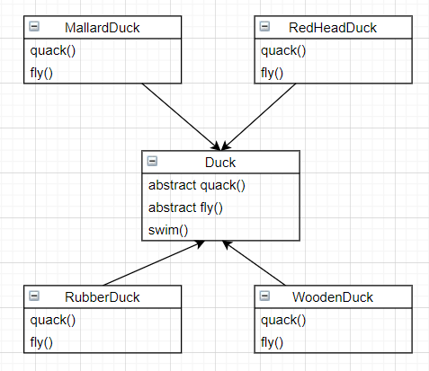
Duck Simulation Game: Problem
Idea: Use abstract methods
Lots of code duplication
Might have to implement same functionality multiple times
Runtime behaviour changes are not possible
Notes:
Our first solution to the problem was to define abstract methods in the base class and let subclasses implement it
But this approach cosed a lot of code duplication and runtime behaviour changes were not possible.

Slide 8
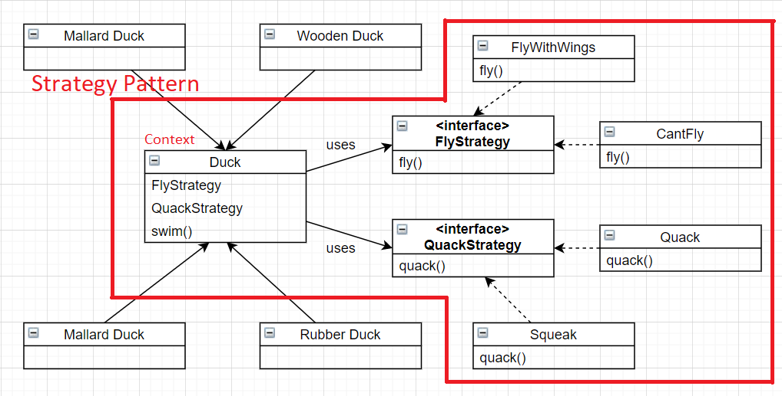
Duck Simulation Game: Solution
Use strategy pattern instead!
Don’t have to write the same code twice
Quack or fly behaviour of ducks can be changed at runtime
Notes:
So we came up with the strategy design pattern which solved these issues by favoring composition.
In this example flying strategy is implemented by 2 different flying strategies
Similarly the quack strategy interface is implemented by 2 different quack strategies

Slide 9
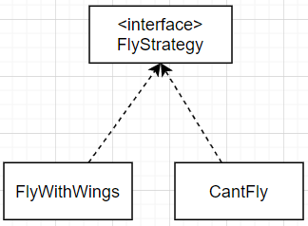
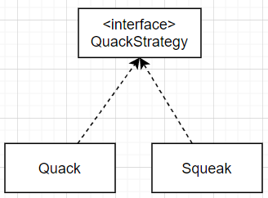
Strategy Pattern: Conclusion
Action 1
Strategy pattern allows context to change between different strategies defined for a single action
Actions are in no way aware of each other
Action 2
Notes:
So in conclusion strategy pattern allowed context to change between different strategies for a single action
And the term action refers to actions that can be performed by the context such as flying and quacking.
And important thing to note is that different implementations for strategies are in no way aware of each other
For example the concerete strategy quack knows nothing about squeak

Slide 10
Presentation Agenda
STATE PATTERN THEORY | OUR APPLICATION | DEVELOPMENT PROCESS
Strategy Pattern State Pattern SOLID Analysis Advantages & Disadvantages Possible Use Cases | Concept of NPC Main Idea State Pattern Alternative Implementations (Testing) | Amazon Leadership Principles TCE Analysis Team Work

Slide 11
Presentation Agenda
STATE PATTERN THEORY | OUR APPLICATION | DEVELOPMENT PROCESS
Strategy Pattern State Pattern SOLID Analysis Advantages & Disadvantages Possible Use Cases | Concept of NPC Main Idea State Pattern Alternative Implementations (Testing) | Amazon Leadership Principles TCE Analysis Team Work
Notes:
So, now lets move onto the state pattern

Slide 12
Extending The Duck Simulation Game
Notes:
Suppose we wanted to extend this duck simulation game

Slide 13
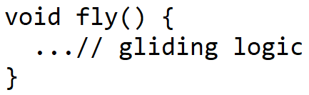
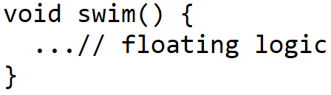
Executing Multiple Actions
Currently duck.fly() and duck.swim() can be called consecutively
This doesn’t make sense. If duck is in air, how can it swim?? (and vice versa)
Notes:
Currently the methods fly and swim can be called consecutively on the ducks
However this doesn’t make sense because after the fly methods is called once the duck must be in air and calling swim method in air doesn’t make any sense

Slide 14
Executing Multiple Actions
Currently duck.fly() and duck.swim() can be called concurrently
This doesn’t make sense. If duck is in air, how can it swim?? (and vice versa)
We need a way to represent the current state the duck is in.
And implement methods based on active state
Notes:
So we need a way to represent the current state the duck is in and implement methods based on this current state.

Slide 15
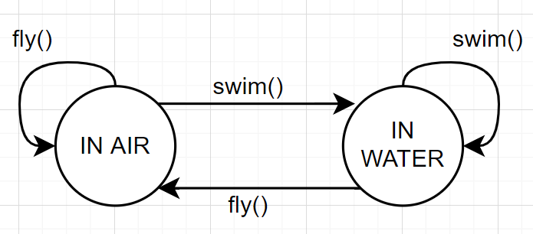
State Diagram
Methods fly() and swim() methods should act differently based on state
Notes:
What we want can be defined by this state diagram you see here.
If the fly method is called in the air we just want duck to keep gliding
However if the fly method is called while the duck is in water. Then it should execute some logic to take the duck from water to air.

Slide 16
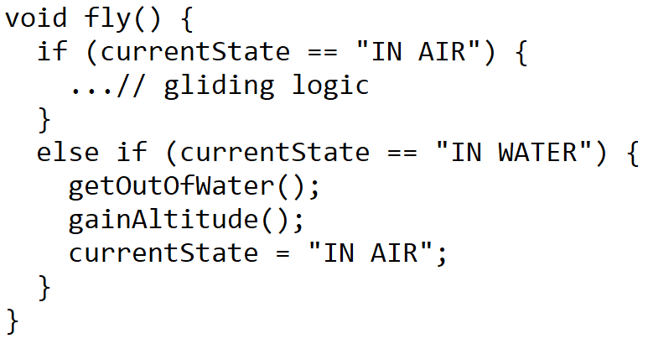
Redefining fly() and swim() Methods
Notes:
In pseudocode the new fly function may be implemented like this

Slide 17
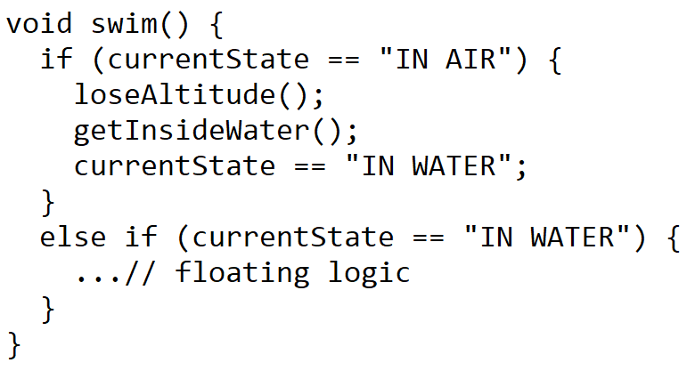
Redefining fly() and swim() Methods
Notes:
And swim function can be implemented similarly based on the current state.

Slide 18
Extending Duck Actions
Notes:
For now this solution seems to work

Slide 19
Extending Duck Actions
What if we want to add more states to duck?
Notes:
But what if we want to extend the possible states for the duck?

Slide 20
Extending Duck Actions
What if we want to add more actions to duck?
Ducks can walk on ground as well!
Notes:
For example the ducks may also walk on the ground

Slide 21
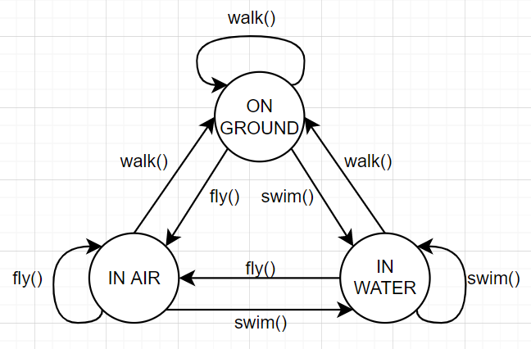
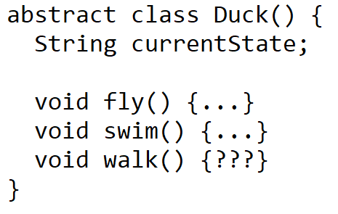
Extending Duck Actions
What if we want to add more states to duck?
Ducks can walk on ground as well!
Notes:
Now we need to modify the duck class and implement a new function called walk
And it will result our previous state diagram to change like you see on the right.

Slide 22
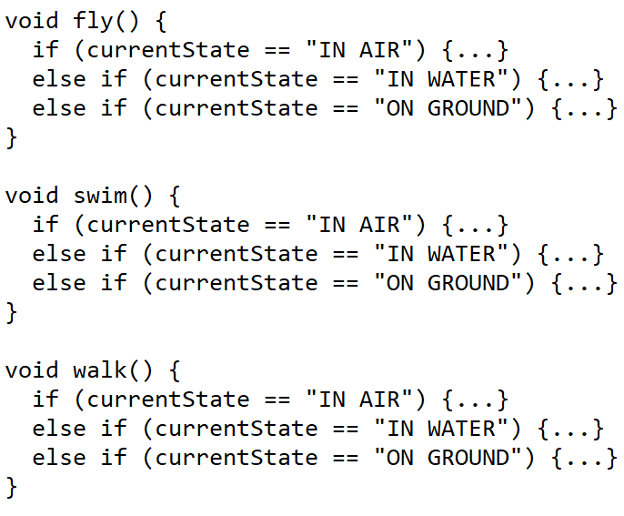
Extending Duck Actions
Notes:
Now, since there are more states we also need to update the fly and swim methods to add these new if statements
As you may notice we keep changing parts of the code and with more states and there are too many if else statements which make the code harder to read.

Slide 23
Problems With Current Implementation
Whenever new state added, code has to be modified
Encapsulate what varies!
Notes:
A problem with the current implementation is that whenever a new state is added, code has to be modified
So we would like to encapsulate what varies and current implementation does not do that

Slide 24
Problems With Current Implementation
Whenever new state added, code has to be modified
Encapsulate what varies!
Context and states should be loosely coupled
Program to an interface not an implementation!
Notes:
We also want context and states to be loosely coupled meaning that we want to be able to perform the actions withour caring for the current state of the context
And the need for loose coupling motivates us to program to an interface not an implementation. Our current implementation also fails at this.

Slide 25
Constructing The State Pattern
Notes:
So now we will see how the state pattern solves these problems by constructing the state pattern for this duck simulation problem

Slide 26
Constructing The State Pattern
Determine context
Context is the object whose states are managed by the state pattern. In our case Duck object.
Notes:
When implenting a state pattern first thing to consider is the context which is the thing whose states are being managed by the state pattern. In our context is the duck.

Slide 27
Constructing The State Pattern (sep this)
Determine context
Context is the object whose states are managed by the state pattern. In our case Duck object.
Determine states
Determine all possible states context can take at any given time. In our case: IN AIR state, IN WATER state and ON GROUND state.
Notes:
Later we need to define the possible states context may be in. In our case context or the duck can be in either in air, in water or on ground so these will be our states.

Slide 28
Constructing The State Pattern (sep this)
Determine context
Context is the object whose states are managed by the state pattern. In our case Duck object.
Determine states
Determine all possible states context can take at any given time. In our case: IN AIR state, IN WATER state and ON GROUND state.
Determine actions
Determine all possible actions which the context can execute. In our case: fly(), swim() or walk()
Notes:
And lastly we determince the possible actions context may execute which are fly swim and walk in our case.

Slide 29
Constructing The State Pattern
Context and states should be loosely coupled
Notes:
As I said earlier we want context and states to be loosely coupled

Slide 30
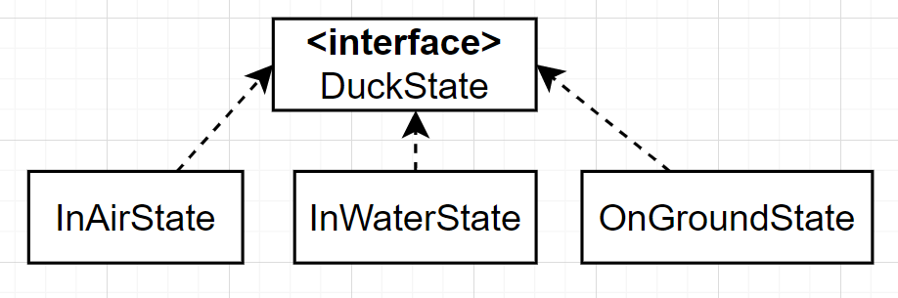
Constructing The State Pattern
Context and states should be loosely coupled
When context wants to perform an action, it should not care what the current state is
Create a common interface for all states.
Notes:
Meaning that context should not care about the current state to perform an action
So we create a common interface for all possible states to implement

Slide 31
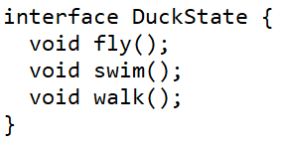
Constructing The State Pattern
Context and states should be loosely coupled
When context wants to perform an action, it should not care what the current state is
Create a common interface for all states.
Each state should be able to perform actions requested by context.
Define interface as all possible actions
Notes:
And inside this interface we define all possible actions that can be performed by the context.

Slide 32
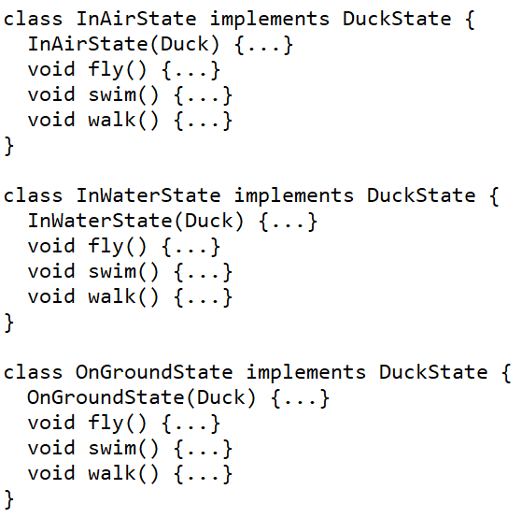


State Classes
States manage the context
They must have a reference to it
Notes:
One important thing to consider for these concrete state calsses is that they will manage the sstates for the context and therefore they will most likely need a reference to it
We make constructor for each of the concrete states to take in the Duck object as parameter

Slide 33
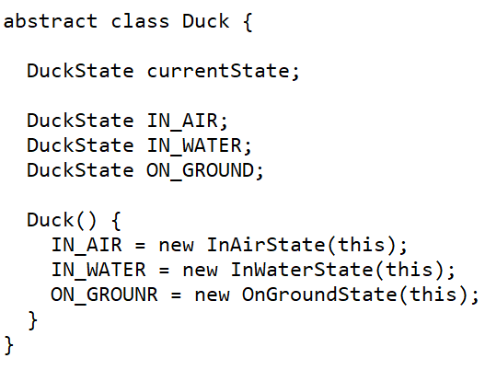
Context Class
Have to preserve state information on each state
Can’t create new state object on each new state change
Instead create them once in context.
Context should also keep a reference to currently active state
Notes:
And as a note on the context class,
We usually want state information to be preserved so we create the states once
This is a difference from the strategy pattern where we instantiate the concrete strategies on demand
And of course we also need a refernce to keep the current state which might be any one of the 3 states.

Slide 34
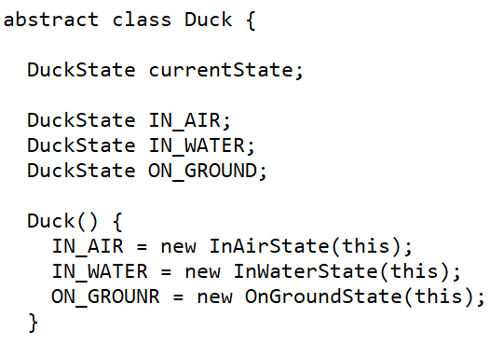
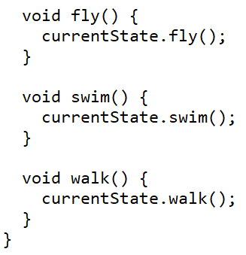
Context Class Action Delegations
After setting up state pattern, delegate context actions to state action
Notes:
We define the necessary actions in the context for clients to use and delegate the implementations to the state pattern
Usually in the state pattern there is a seperate class called client which makes use of the context. So we define this actions and delegate the implementation to the state pattern
However if the context and client are the same class then these function definitions may be unnecessary

Slide 35
Implementation Examples
Notes:
Now after all the steps we described we have finally set up the state pattern and only thing left is to actually implement the concrete states.

Slide 36
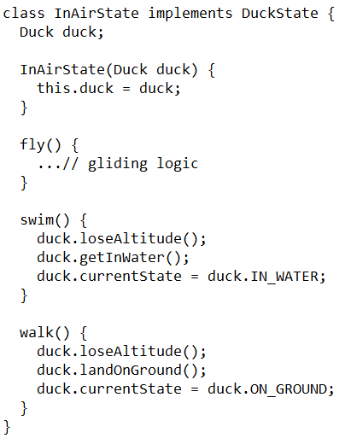
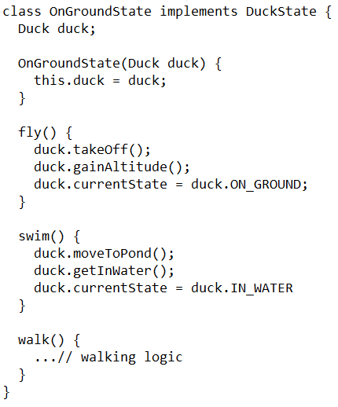
Notes:
And doing so becomes very easy and intuitive with the help of state pattern

Slide 37
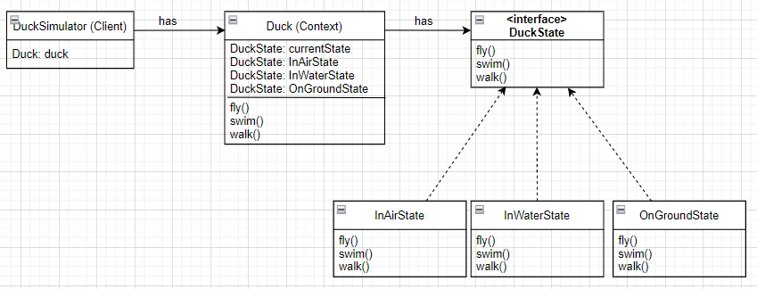
Overall uml diagram
Notes:
The overall diagram for the state pattern is like this.
As you may realize it is very similar to the strategy pattern

Slide 38
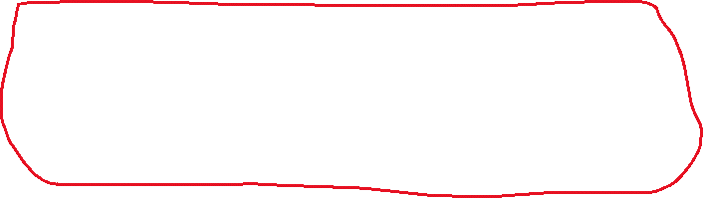
Overall uml diagram
States are aware of each other
Notes:
But one main difference is that states are aware of each other and may make the context switch from one state to another as we’ve seen in the previous example
For example if we consider a sorting strategy interface and the concrete sorting implementations, say, bubble sort and quick sort. These strategies would not be aware of each other
Other difference is that strategy pattern is defined for single action like fly or quack and state pattern defines several actions like fly swim and walk. This actually causes some problems

Slide 39
Unwanted Transitions
Notes:
Problems such as being forced to implement functionality.

Slide 40
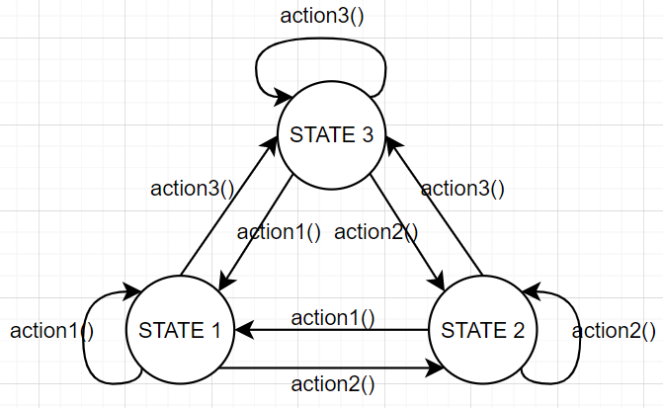
What About Unwanted Transitions?
For previous implementation, state diagram is fully connected graph
Notes:
The previously shown implementation defines a fully connected state diagram like shown on this figure

Slide 41
What About Unwanted Transitions?
For previous implementation, state diagram is fully connected graph
That is what we wanted!
Notes:
And for the duck simulation game this was what we wanted

Slide 42
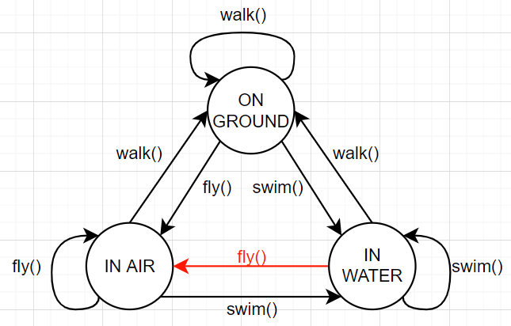
What About Unwanted Transitions?
For previous implementation, state diagram is fully connected graph
That is what we wanted!
Maybe duck shouldn’t be able to directly go from IN WATER to IN AIR
Don’t want the red transition
Notes:
But requirements may change. For example consider we don’t ducks to be able to go from directly from water to air.

Slide 43
What About Unwanted Transitions?
Design forces us to implement this function
Disadvantage of state pattern, more on next slides
Notes:
But as I said earlier state design pattern forces us to implement this function.

Slide 44
What About Unwanted Transitions?
What to do about forced function?
Notes:
So what can we do about these forced function implementations.

Slide 45
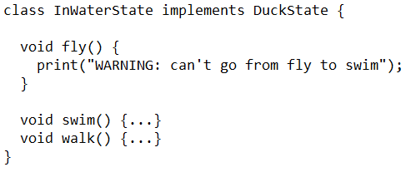
What About Unwanted Transitions?
What to do about forced function?
Notes:
Depending on the application we might either want to warn the users

Slide 46
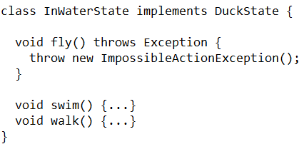
What About Unwanted Transitions?
What to do about forced function?
Notes:
Or maybe throw an exception to let another programmer know that this action is not doable for the current state

Slide 47
Presentation Agenda
STATE PATTERN THEORY | OUR APPLICATION | DEVELOPMENT PROCESS
Strategy Pattern State Pattern SOLID Analysis Advantages & Disadvantages Possible Use Cases | Concept of NPC Main Idea State Pattern Alternative Implementations (Testing) | Amazon Leadership Principles TCE Analysis Team Work
Notes:
Now the ensar will continue with solid analysis for the state pattern

Slide 48
Presentation Agenda
STATE PATTERN THEORY | OUR APPLICATION | DEVELOPMENT PROCESS
Strategy Pattern State Pattern SOLID Analysis Advantages & Disadvantages Possible Use Cases | Concept of NPC Main Idea State Pattern Alternative Implementations (Testing) | Amazon Leadership Principles TCE Analysis Team Work
Notes:
Hello everyone in this section we will look at which solid design principles the state pattern follows

Slide 49
Single Responsibility Principle
Notes:
We will first look at the single responsibility principle

Slide 50
Single Responsibility Principle
Single Responsibility Principle suggests each class should be responsible from single functionality.
Notes:
Single Responsibility Principle suggests that each class should be responsible from single functionality.

Slide 51
Single Responsibility Principle
Single Responsibility Principle suggests each class should be responsible from single functionality.
In initial design, duck class contained:
low level functions: gainAltitude(), loseAltitude(), getInWater() etc.
high level functions: fly(), swim(), etc.
Notes:
However in our first implementation the duck class contained both low level functions such as ‘’gain altitude’’, ‘’lose altitude’’ and so on.
But it also contained high level functions such as fly and swim which manage the states for the duck.

Slide 52
Single Responsibility Principle
Single Responsibility Principle suggests each class should be responsible from single functionality.
In initial design, duck class contained:
low level functions: gainAltitude(), loseAltitude(), getInWater() etc.
high level functions: fly(), swim(), etc.
This was against SRP principle
State pattern fixed it by encapsulating the state logic in different module
Notes:
This is against the single responsibility principle but state pattern fixes this by encapsulating the different states in their own classes such as InAirState, InWaterState and so on.

Slide 53
Open Closed Principle
Notes:
Next, we will move onto open closed principle

Slide 54
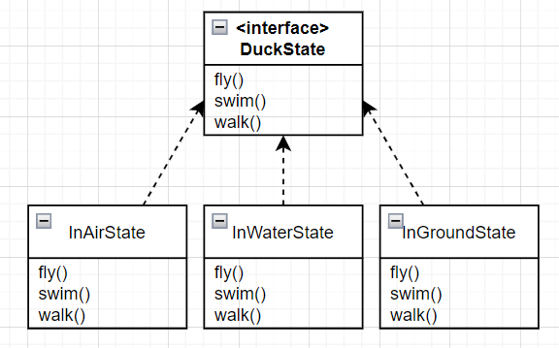
Open Closed Principle
Notes:
In our initial design there were 3 states namely, air, water and ground states

Slide 55
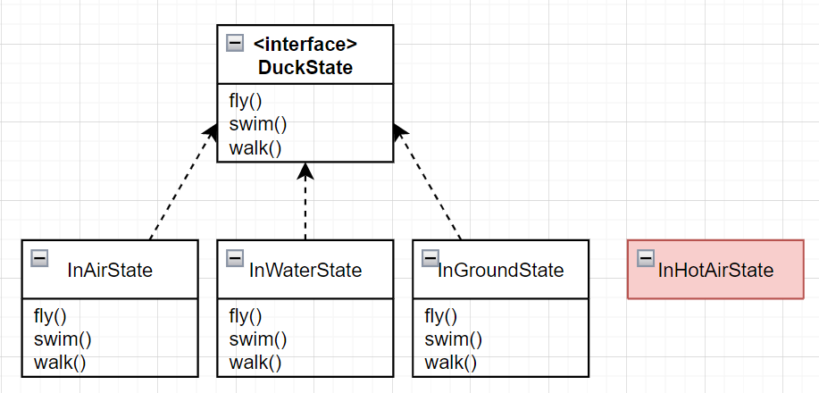
Open Closed Principle
Extending States
Notes:
We might want to extend states with a new state called HotAir state for example
We might want to ducks to behave differently in hot air differently then they do in normal air.

Slide 56
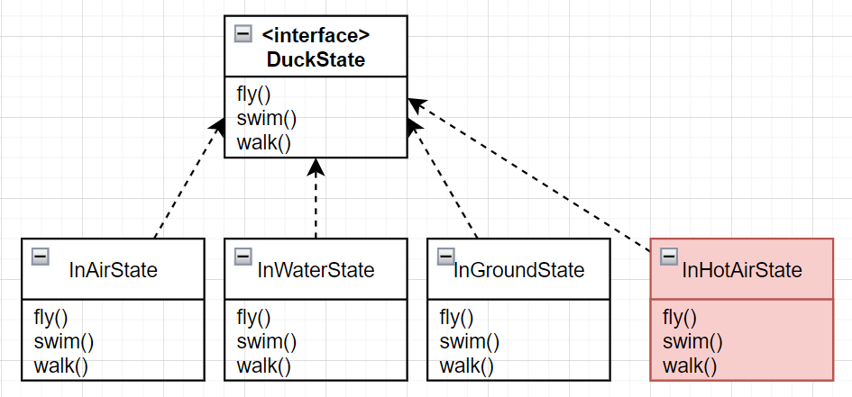
Open Closed Principle
Extending States → Just implement the interface
Notes:
Just implementing the duck state interface for the new state will make the new state available to us.

Slide 57
Interface Segregation Principle
Notes:
Now we move onto interface segregation principle

Slide 58
Interface Segregation Principle
What is interface segregation?
Notes:
So what is the interface segregation principle?

Slide 59
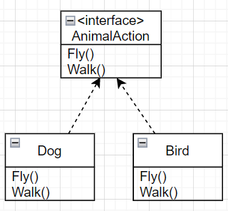
Interface Segregation Principle
What is interface segregation?
Notes:
Consider this animal action interface which has two methods fly and walk and each animal implements this interface

Slide 60
Interface Segregation Principle
What is interface segregation?
Dog implements uneccessary fly()
Notes:
With a design like this the dog class is forced to implement the uneccessary fly function

Slide 61
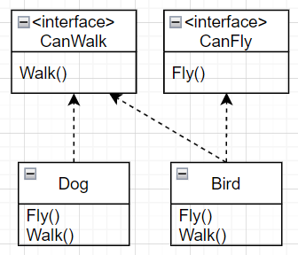
Interface Segregation Principle
What is interface segregation?
Dog implements uneccessary fly()
Seperate the interfaces
Notes:
Interface segregation principle suggests that we should seperate this interface into two more specific interfaces such as CanWalk and CanFly interfaces.

Slide 62
Interface Segregation Principle
Does state pattern follow isp?
Notes:
So, does the state pattern follow the interface segregation principle?

Slide 63
Interface Segregation Principle
Does state pattern follow isp?
Exactly the opposite…
Notes:
It actually does the exact opposites by gathering up all the actions in a single interface and violates this principle

Slide 64
Interface Segregation Principle
Does state pattern follow isp?
Exactly the opposite…
Notes:
And Berke actually talked about the results of this in the earlier sections.
Even though we did not want to allow for fly transition shown here in red, state pattern forced us to implement it

Slide 65
Interface Segregation Principle
Does state pattern follow isp?
Exactly the opposite…
Notes:
And in the same previous sections, some solutions were considered like warning the user or throwing an exception for these forced functions

Slide 66
Interface Segregation Principle
Does state pattern follow isp?
Exactly the opposite…
…but for a good reason!
Notes:
However the state pattern violates this principle for a good reason

Slide 67
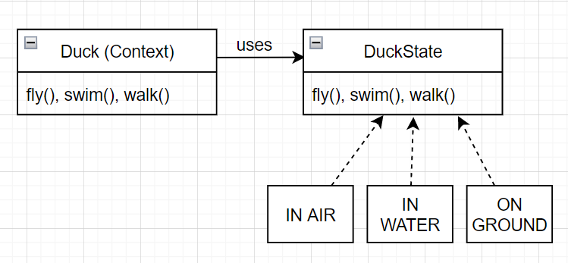
Interface Segregation Principle
Does state pattern follow isp?
Exactly the opposite…
…but for a good reason!
Context does not have to care for it’s state
Notes:
Gathering all the methods in a single interface allows for context to not care about the current state and just call the method it wants

Slide 68
Dependency Inversion Principle
Notes:
And finally we will talk about the dependency inversion principle

Slide 69
Dependecy Inversion principle
Overall goal of state pattern:
Context should perform actions (fly, swim, walk)...
Notes:
Our overall goal with state pattern is to be able to perform context actions such as fly, swim and walk

Slide 70
Dependecy Inversion principle
Overall goal of state pattern:
Context should perform actions (fly, swim, walk)...
…without caring for current state
Notes:
Without having to care for the current state and let the state be maintened by the state pattern

Slide 71
Dependecy Inversion principle
Overall goal of state pattern:
Context should perform actions (fly, swim, walk)... → high level module
…without caring for current state → low level module
Notes:
So, we may think of actions as high level modules and state information as low level module from the context’s point of view.

Slide 72
Dependecy Inversion principle
Dependency Inversion Principle:
Higher level modules should not depend on lower modules
Notes:
The dependecy inversion principle states that higher level modules should not depend on lower level modules

Slide 73
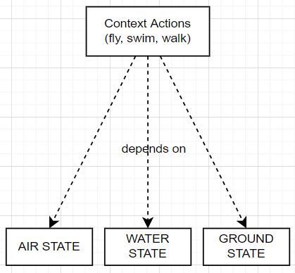
Dependecy Inversion principle
Dependency Inversion Principle:
Higher level modules should not depend on lower modules
Notes:
However this is the case for the intial if-else implementation we saw in the previous sections.
As you can see on the code at right these context actions directly depend on the current state

Slide 74
Dependecy Inversion principle
Dependency Inversion Principle:
Higher level modules should not depend on lower modules
Both should depend on abstraction
Notes:
Dependency inversion principle suggests that both high and low level modules should depend on abstractions

Slide 75
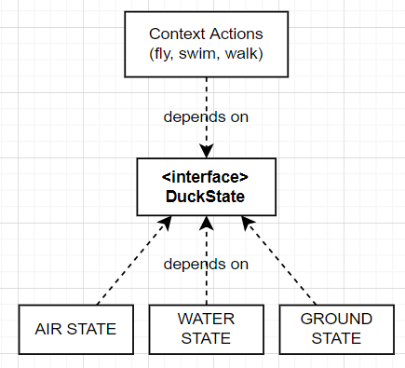
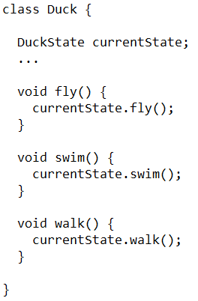
Dependecy Inversion principle
Dependency Inversion Principle:
Higher level modules should not depend on lower modules
Both should depend on abstraction
Notes:
This requirement is satisfied with the state pattern.
Now both the context actions (or high level modules) and state information (or low level module) depend on the state interface abstraction
And as we can see from the code context actions can be performed without caring for the state information

Slide 76
Dependecy Inversion principle
Dependency Inversion Principle:
Higher level modules should not depend on lower modules
Both should depend on abstraction
STATE PATTERN
Notes:
So the state pattern inverts the dependencies and is compliant with the depedency inversion principle

Slide 77
Presentation Agenda
STATE PATTERN THEORY | OUR APPLICATION | DEVELOPMENT PROCESS
Strategy Pattern State Pattern SOLID Analysis Advantages & Disadvantages Possible Use Cases | Concept of NPC Main Idea State Pattern Alternative Implementations (Testing) | Amazon Leadership Principles TCE Analysis Team Work
Notes:
Now I will move onto some advantages and disadvantages of the state pattern

Slide 78
Presentation Agenda
STATE PATTERN THEORY | OUR APPLICATION | DEVELOPMENT PROCESS
Strategy Pattern State Pattern SOLID Analysis Advantages & Disadvantages Possible Use Cases | Concept of NPC Main Idea State Pattern Alternative Implementations (Testing) | Amazon Leadership Principles TCE Analysis Team Work
Notes:
Now I will move onto some advantages and disadvantages of the state pattern

Slide 79
Advantages
Encapsulates the varying parts
Code is easier to maintain
Notes:
One of the advantages of the state pattern is that it capsulates the varying parts and code becomes easier to read and maintain

Slide 80
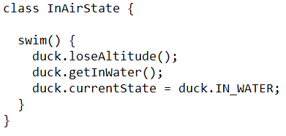
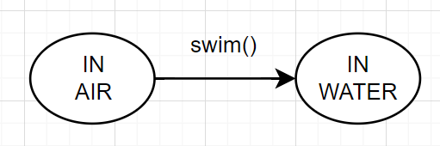
Advantages
Encapsulates the varying parts
Code is easier to maintain
Implementing logic becomes intuitive
Notes:
Moreover, implenting the functions for each state becomes very intuitive
For example for the ‘’InAirState’’ swim method should define the logic for transitioning from air to water state.
For that to happen the duck just needs to lose altitude and get inside water. Additionally the new state is set as IN WATER state

Slide 81
Advantages
Encapsulates the varying parts
Code is easier to maintain
Implementing logic becomes intuitive
Inverts dependencies
More flexible code
Notes:
Another advantage is state pattern is complies with dependency inversion principle which makes our code more flexible compared to initial if-else implementation.

Slide 82
Disadvantages
Violates interface segregation principle
Notes:
One major disadvantage of the state pattern is that it violates the interface segregation principle

Slide 83
Disadvantages
Violates interface segregation principle
Forces implementation
May cause bloated code
Notes:
Meaning that it forces implementation of methods and may cause bloated code

Slide 84
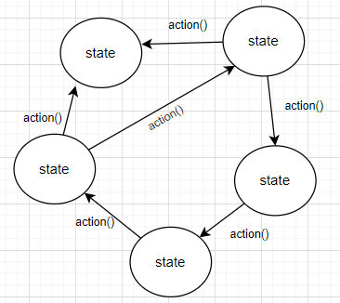
Disadvantages
Violates interface segregation principle
Forces implementation
May cause bloated code
Especially for sparse graphs!
Notes:
This is especially true for state diagrams that are sparse graphs.
Given a state diagram like the on the right

Slide 85
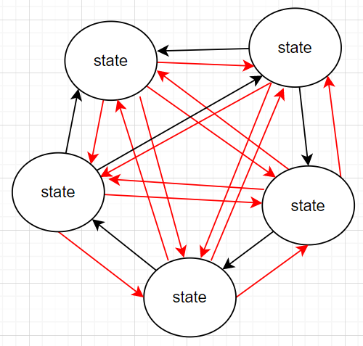
Disadvantages
Violates interface segregation principle
Forces implementation
May cause bloated code
Especially for sparse graphs!
Notes:
Applying state pattern will force us to implement all the transitions shown in red which are a lot of transitions.

Slide 86
Presentation Agenda
STATE PATTERN THEORY | OUR APPLICATION | DEVELOPMENT PROCESS
Strategy Pattern State Pattern SOLID Analysis Advantages & Disadvantages Possible Use Cases | Concept of NPC Main Idea State Pattern Alternative Implementations (Testing) | Amazon Leadership Principles TCE Analysis Team Work

Slide 87
Presentation Agenda
STATE PATTERN THEORY | OUR APPLICATION | DEVELOPMENT PROCESS
Strategy Pattern State Pattern SOLID Analysis Advantages & Disadvantages Possible Use Cases | Concept of NPC Main Idea State Pattern Alternative Implementations (Testing) | Amazon Leadership Principles TCE Analysis Team Work
Notes:
Now finally for this section I will very briefly talk about some other possible use cases for the state pattern

Slide 88
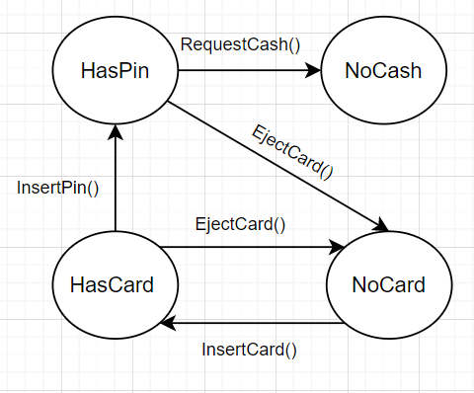
ATM Machine
Actions: InsertCard, EjectCard, InsertPin, RequestCash
States: HasCard, NoCard, HasPin, NoCash
Notes:
For example the behaviour of an atm machine can be defined by a state diagram and therefore can be implemented by the state design pattern
An atm machine might have the actions insert card, eject card, insert pin request cash
And the states: has card, no card, has pin, no cash
The transitions between these states could be as shown in the diagram

Slide 89
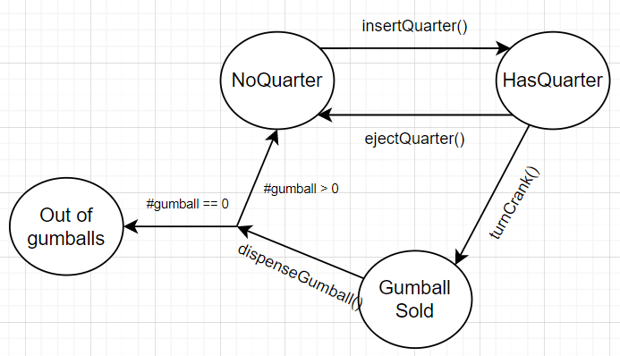
Gumball Machine
Actions: insertQuarter(), ejectQuarter(), turnCrank(), dispenseGumball()
States: HasQuarter, NoQuarter, GumballSold, OutOfGumballs
Notes:
Similar to ATM machine behaviour of a gumball machine can be defined by a state diagram.
A gumball machine might have actions such as insert quarter, eject quarter, turn crank and dispense gumball
And the states: has quarter no quarter gumballs sold and out of gumballs

Slide 90
Presentation Agenda
STATE PATTERN THEORY | OUR APPLICATION | DEVELOPMENT PROCESS
Strategy Pattern State Pattern SOLID Analysis Advantages & Disadvantages Possible Use Cases | Concept of NPC Main Idea State Pattern Alternative Implementations (Testing) | Amazon Leadership Principles TCE Analysis Team Work
Notes:
Now Berkay will continue with our own project and implementation of the state pattern

Slide 91
Presentation Agenda
STATE PATTERN THEORY | OUR APPLICATION | DEVELOPMENT PROCESS
Strategy Pattern State Pattern SOLID Analysis Advantages & Disadvantages Possible Use Cases | Concept of NPC Main Idea State Pattern Alternative Implementations (Testing) | Amazon Leadership Principles TCE Analysis Team Work

Slide 92
Presentation Agenda
STATE PATTERN THEORY | OUR APPLICATION | DEVELOPMENT PROCESS
Strategy Pattern State Pattern SOLID Analysis Advantages & Disadvantages Possible Use Cases | Concept of NPC Main Idea State Pattern Alternative Implementations (Testing) | Amazon Leadership Principles TCE Analysis Team Work
Notes:
We will start this section by introducing the concept of NPCs

Slide 93

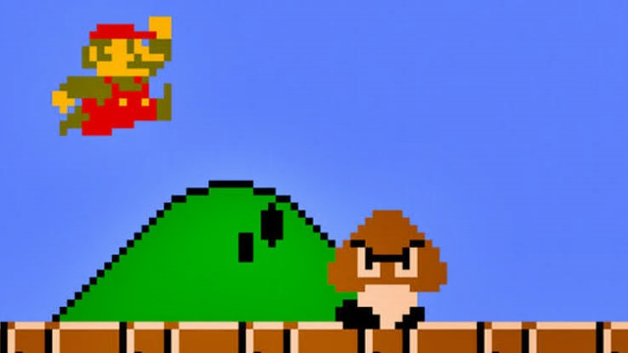
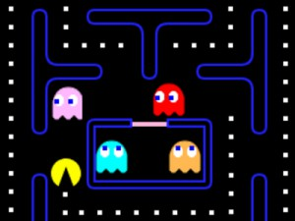
Concept of NPCs
NPCs are non-playable characters in games
Notes:
NPCs are non-playable characters in games such as these Brown mushroom like creatures in mario, ghosts in pac-man and zombies in minecraft.

Slide 94
States of a NPC
NPCs operate in terms of states
Notes:
Most of the time NPCs operate in terms of state.

Slide 95
States of a NPC
NPCs operate in terms of states
If no player, wander around randomly
Notes:
For example if we consider the zombie npc from minecraft they wander around randomly if there is no player nearby

Slide 96
States of a NPC
NPCs operate in terms of states
If no player, wander around randomly
If player nearby, chase it
Notes:
And if there is a player nearby they try to chase and kill it.

Slide 97
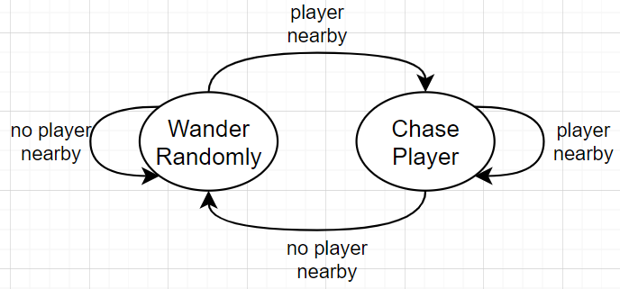
States of a NPC
NPCs operate in terms of states
If no player, wander around randomly
If player nearby, chase it
Notes:
These behaviours of the zombie npc can be defined with this simple state diagram.
And therefore state pattern can be used for implementing this behaviour.

Slide 98
States of a NPC
State pattern is widely used in industry!
Notes:
And in fact state pattern is widely used in industry for implementing npc behaviours

Slide 99
Presentation Agenda
STATE PATTERN THEORY | OUR APPLICATION | DEVELOPMENT PROCESS
Strategy Pattern State Pattern SOLID Analysis Advantages & Disadvantages Possible Use Cases | Concept of NPC Main Idea State Pattern Alternative Implementations (Testing) | Amazon Leadership Principles TCE Analysis Team Work

Slide 100
Presentation Agenda
STATE PATTERN THEORY | OUR APPLICATION | DEVELOPMENT PROCESS
Strategy Pattern State Pattern SOLID Analysis Advantages & Disadvantages Possible Use Cases | Concept of NPC Main Idea State Pattern Alternative Implementations (Testing) | Amazon Leadership Principles TCE Analysis Team Work
Notes:
Now we will talk about the main idea behind our own project

Slide 101

Main Idea
Want to design an npc
Notes:
In our project we also wanted to create an npc simulation game, in which npcs are depicted with a simple circle like this

Slide 102

Main Idea
Want to design an npc
Should wander around
Notes:
First, we want our npcs to be able to wander around the map

Slide 103

Main Idea
Want to design an npc
Should wander around
Should collect point when in range
Notes:
And if it encounters a point within it’s range we want it to collect the point and take it back to its base which is shown with a semicircle on the left side of the map
The white circle around the npc shows it’s range in other words how far it can see.

Slide 104

Main Idea
Want to design an npc
Should wander around
Should collect point when in range
Should attack enemy NPC when in range
NPC should be able to die
Notes:
And finally, we want our npcs to be able to attack enemy npc when they encounter them
And of course as a result, npcs should be able to die.
In this case blue npc kills the red one.

Slide 105
Presentation Agenda
STATE PATTERN THEORY | OUR APPLICATION | DEVELOPMENT PROCESS
Strategy Pattern State Pattern SOLID Analysis Advantages & Disadvantages Possible Use Cases | Concept of NPC Main Idea State Pattern Alternative Implementations (Testing) | Amazon Leadership Principles TCE Analysis Team Work

Slide 106
Presentation Agenda
STATE PATTERN THEORY | OUR APPLICATION | DEVELOPMENT PROCESS
Strategy Pattern State Pattern SOLID Analysis Advantages & Disadvantages Possible Use Cases | Concept of NPC Main Idea State Pattern Alternative Implementations (Testing) | Amazon Leadership Principles TCE Analysis Team Work
Notes:
Now we will move onto constructing the state pattern for this application and explain the project implementation from a high level.

Slide 107
Constructing The State Pattern
What is the context? (whose states are being maintained?)
Notes:
First thing to consider when implementing state pattern is deciding the context.
Context is the thing whose states will be maintained by the state pattern.

Slide 108
Constructing The State Pattern
What is the context? (whose states are being maintained?)
NPC is context!
Notes:
In our case NPC is the context.

Slide 109
Constructing The State Pattern
What is the context? (whose states are being maintained?)
NPC is context!
What are possible states for the context?
Notes:
Next we should consider what are the possible states the context can be in

Slide 110
Constructing The State Pattern
What is the context? (whose states are being maintained?)
NPC is context!
What are possible states for the context?
Wandering, Collecting, Attacking, Death
Notes:
For our case there are 4 states namely, wandering, collecting, attacking and death states

Slide 111
Constructing The State Pattern
What is the context? (whose states are being maintained?)
NPC is context!
What are possible states for the context?
Wandering, Collecting, Attacking, Death
What are possible actions by the context?
Notes:
Finally we should consider what are the possible actions context may be required to do
We should consider these actions independently from the possible states

Slide 112
Constructing The State Pattern
What is the context? (whose states are being maintained?)
NPC is context!
What are possible states for the context?
Wandering, Collecting, Attacking, Death
What are possible actions by the context?
CheckAndWander, CheckAndCollect, CheckAndAttack, CheckAndDie
Notes:
However by the nature of our project there is 1 to 1 correspondance between actions and states.
There are 4 actions named CheckAndWander, CheckAndCollect, CheckAndAttack, CheckAndDie
These actions should check whether environmental conditions are satisfied to perform the action and if so perform the action
For example CheckAndAttack may check if there are nearby enemies and if so depending on the current state either transition to attacking state or actually attack the enemy

Slide 113
Constructing The State Pattern
Context: NPC
Possible States:
Wandering State
Collecting State
Attacking State
Death State
Possible Actions (by context):
CheckAndWander
CheckAndCollect
CheckAndAttack
CheckAndDie
Notes:
Using all these informations we will now define the classes and interfaces used in our project

Slide 114
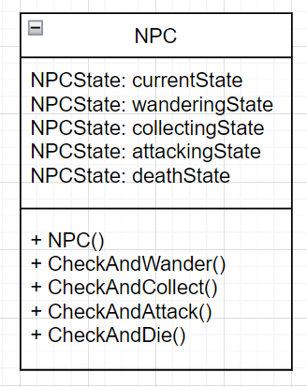




Constructing The State Pattern
Context: NPC
Possible States:
Wandering State
Collecting State
Attacking State
Death State
Possible Actions (by context):
CheckAndWander
CheckAndCollect
CheckAndAttack
CheckAndDie
Notes:
First we create the NPC or the context class.
Context class should hold a reference to each possible state
Also it should implement the possible actions it may perform but as you know these actions are not actually implemented in npc but rather delegated to state pattern

Slide 115
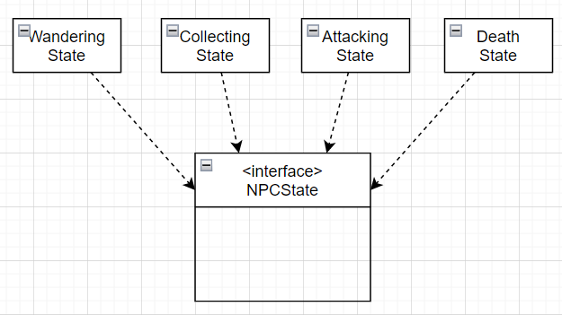
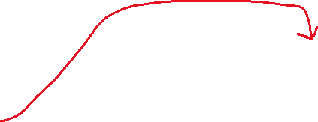

Constructing The State Pattern
Context: NPC
Possible States:
Wandering State
Collecting State
Attacking State
Death State
Notes:
Next we create an interface as NPCState and create concrete classes for each possible state which implement this interface

Slide 116
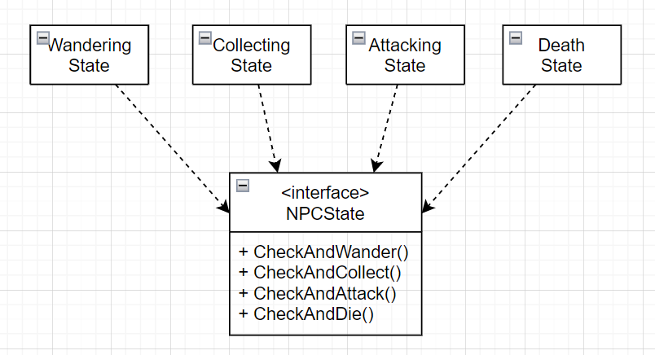


Constructing The State Pattern
Context: NPC
Possible States:
Wandering State
Collecting State
Attacking State
Death State
Possible Actions (by context):
CheckAndWander
CheckAndCollect
CheckAndAttack
CheckAndDie
Notes:
We also define the methods of the interface as possible actions from the viewpoint of context which are these 4 actions as described earlier

Slide 117


Context Action Delegations
Notes:
Finally we delegate the actions from context to state pattern inside the NPC class as you can see on the righthand side

Slide 118


NPC manager and calls to context
Notes:
One other class in our porject is the NPCManager whose only job is to make a call to actions of the context.
These actions are called a function named Update() which is a function provided by Unity Game Engine
This function is executed by unity at each frame of the game
So in other words in our game we are constantly checking whether the npc should die, wander, collect or attack
And of course perform the corresponding action within the same method.
You can see the final version of the project structure on the right.
In this case NPCManager class is called client for the context.

Slide 119
Transitions For The NPC
Notes:
Now we will very briefly talk about the transitions for the npc.

Slide 120

State Diagram
Can’t switch between attack and collect
Just our choice! Could be allowed…
Notes:
For the 3 states attack wander and collect we arbitrarily defined the transitions like this
As you can see in this setup NPC can’t switch from attack to collect state

Slide 121

State Diagram
Notes:
And for the death state, npcs can switch to death state from any other state given their health drops to 0.
But NPCs can not switch from death state back to any other state
Therefore transitions are defined like this.

Slide 122

There is a problem…
Violates single responsibility principle!
Notes:
However there is a minor problem with this implementation
The functions defined here violate the single responsibility principle
This is because they both check whether environmental conditions are satisfied to switch between states
And they also carry out the switching logic from one state to another

Slide 123

Solution
Violates single responsibility principle!
Seperate to different functions
Notes:
So we seperate these functions into 2 functions.
Where one of the functions check whether conditions are (HasToDie() function)
And other function makes the actual transition (Die() function)

Slide 124


Update NPCState interface
Notes:
We update our code accordingly for NPCState interface
We seprate each of the functions as you can see.

Slide 125

Update NPCManager class
Notes:
We also update the npc manager class like this

Slide 126


Finally, implementations
Notes:
Now the state pattern is fully set-up. Only thing left to do is implement the actual functions
But of course we won’t go into details of implementations since it will take too long and may confuse you.
After implementing all the functions we reach to the final product.
And we will look at a demonstration of it.
(DEMOYA GEÇ)

Slide 127
Where does the strategy pattern fit in?
Notes:
So, we might ask ourselves where does strategy pattern compared to what we have now.

Slide 128

Where does the strategy pattern fit in?
Notes:
We can implement a strategy pattern alongside the state pattern.
The strategy pattern, for example, could allow NPCs to switch between different strategies for wandering
For example right now NPCs wander around randomly but we could have implemented a keyboard wandering strategy where wandering is done by the user with input from keyboard

Slide 129
Presentation Agenda
STATE PATTERN THEORY | OUR APPLICATION | DEVELOPMENT PROCESS
Strategy Pattern State Pattern SOLID Analysis Advantages & Disadvantages Possible Use Cases | Concept of NPC Main Idea State Pattern Alternative Implementations (Testing) | Amazon Leadership Principles TCE Analysis Team Work

Slide 130
Presentation Agenda
STATE PATTERN THEORY | OUR APPLICATION | DEVELOPMENT PROCESS
Strategy Pattern State Pattern SOLID Analysis Advantages & Disadvantages Possible Use Cases | Concept of NPC Main Idea State Pattern Alternative Implementations (Testing) | Amazon Leadership Principles TCE Analysis Team Work
Notes:
Now we will briefly talk about other possible ways to implement our project and show why state pattern is a better choice.

Slide 131


Alternative Implementations (Testing)
If else implementation
Notes:
First implementation that comes to mind is to use if else structures without using any design pattern at all.

Slide 132
Alternative Implementations (Testing)
If else implementation
Complicated code, hard to maintain
Notes:
However so many if else clauses complicate the code and make it harder to read.
Aditionally parts that are likely to change are not encapsulated and this violates the design principle that says ‘’Encapsulate what varies’’

Slide 133
Alternative Implementations (Testing)
If else implementation
Complicated code, hard to maintain
Violates single responsibility
Notes:
Another problem with this implementation is that states are now have to be manged by context itself
And as we saw in the first section of our presentation this violates the single responsibility principle

Slide 134
Alternative Implementations (Testing)
If else implementation
Complicated code, hard to maintain
Violates single responsibility and dependency inversion
Notes:
Lastly, this implementation violates the design principle which states ‘’Program to an interface not an implementation’’
Therefore extending this code with new states is much harder compared to state pattern.

Slide 135


Alternative Implementations (Testing)
Strategy Pattern implementation
Notes:
Another way to implement this project is to use strategy pattern

Slide 136


Alternative Implementations (Testing)
Strategy Pattern implementation
Code is less complicated to if-else
Notes:
This implementation is less complicated compared to if-else implementation.
As you can see in the code we can define the logic for performing a single action using the strategy pattern.

Slide 137
Alternative Implementations (Testing)
Strategy Pattern implementation
Code is less complicated to if-else
Strategies are unaware of each other → Context still has to manage states
Notes:
However since different strategies are not aware of each other in strategy pattern, context still has to manage its own states.
Which means we still violate the single responsibility principle

Slide 138
Presentation Agenda
STATE PATTERN THEORY | OUR APPLICATION | DEVELOPMENT PROCESS
Strategy Pattern State Pattern SOLID Analysis Advantages & Disadvantages Possible Use Cases | Concept of NPC Main Idea State Pattern Alternative Implementations (Testing) | Amazon Leadership Principles TCE Analysis Team Work
Notes:
This is all for the state pattern for our project now Muhammed will talk to you about the development process of our project

Slide 139
Presentation Agenda
STATE PATTERN THEORY | OUR APPLICATION | DEVELOPMENT PROCESS
Strategy Pattern State Pattern SOLID Analysis Advantages & Disadvantages Possible Use Cases | Concept of NPC Main Idea State Pattern Alternative Implementations (Testing) | Amazon Leadership Principles TCE Analysis Team Work
Notes:
I will talk to you about development process of our project

Slide 140
Presentation Agenda
STATE PATTERN THEORY | OUR APPLICATION | DEVELOPMENT PROCESS
Strategy Pattern State Pattern SOLID Analysis Advantages & Disadvantages Possible Use Cases | Concept of NPC Main Idea State Pattern Alternative Implementations (Testing) | Amazon Leadership Principles TCE Analysis Team Work
Notes:
We will first start by looking at how we embraced amazon leadership principles in our project

Slide 141

Amazon Leadership Principles
What are the Amazon Leadership Principles?
Set of principles imposed by amazon on their employees.
16 principles in total, we look at 4
Customer Obsession
Ownership
Think Big
Deliver Results
Notes:
Amazon Leadership Principles is one of the approaches we consider during the development process.What are the Amazon Leadership Principles ,
But what are they?
Amazon Leadership Principles, which are set of principles imposed by Amazon on their employees. There are 16 principles in total but I’m gonna explain just 4 of them.
(its a trivia for you : Amazon added 2 new principles in this year, just before Jeff Bezos steps down as CEO)
Strive to be Earth’s Best Employer , Success and Scale bring broad responsibility

Slide 142
Customer Obsession
Notes:
First of all, customer obsession

Slide 143


Customer Obsession
“You have to start with the customer experience and work backwards towards the technology.”
Steve Jobs
Notes:
There is a quote from Steve Jobs and I know this is about amazon principles but you know great minds think alike.

Slide 144

Customer Obsession
Start with customer and work backwards, obsess over customers
Customer is the class!
Notes:
So customer obsession , Start with customer and work backwards, obsess over customers
in this situation customer is the class, (and yes we obsessed about you.)

Slide 145
Customer Obsession
Notes:
Let me explain how, for the theory part of the presentation, we started with a familiar example for you , with duck example. We thought that you would understand better when it is explained through an example you are used to.
We explained the transition from Strategy Pattern to State Pattern step by step with reasons and provide a few other use cases. Such as ATM machine and Gumball Machine.

Slide 146

Customer Obsession
Notes:
And for the application part of the presentation, While choosing the project topic, we paid attention to make it an interesting topic for the class. We made a visually interesting project with unity about NPC’s, So we thought games and NPCs were an interesting topic and that we could attract the attention of the class.

Slide 147
Customer Obsession
Notes:
As in the theory part, we preferred to explain step by step in the Application part. For clarity, we've included gifs showing each state working. It could be difficult to distinguish between states and transitions as the game runs randomly.
We even showed the ranges in these gifs so that it can be understood more clearly. Range are not shown in the game.

Slide 148

Customer Obsession
Notes:
We have also shown the player healths and their current states on the game screen for clear understanding about how states change during game.

Slide 149
Ownership
Notes:
Second principle is ownership.

Slide 150

Ownership
Act on behalf of the team, never say "not my job!"
Notes:
Ownership Principle means taking ownership of your team and project.
Taking ownership of your work prevents those issues by showing others that you can be trusted, even when the job is serious. If everyone on your team is doing his or her part, big or small, then everything runs more smoothly. And we as a team tried to do that.
Everyone in the team embraced the project and fulfilled their own tasks. In this way, the project was completed without any problems between the team members.

Slide 151
Think Big
Notes:
Third one is Think Big.

Slide 152


Think Big
Think of new possible ways to serve customers and act boldly
Notes:
Think Big is thinking differently and acting boldly. Think differently and look around corners and expand these corners for new possible ways to serve customers.

Slide 153
Think Big
Think of new possible ways to serve customers
Instead of conceptual example, we provided a real world use case
Notes:
For example,to serve you guys better Instead of a conceptual example, we provided a real world use case. NPC’s are real-world use cases for state pattern. And it’s a bold move because most of the team members had no experience on Unity and C#

Slide 154
Deliver Results
Notes:
Last principle and one of the most important principles is Deliver Results

Slide 155


Deliver Results
Deliver results in a timely fashion
Despite setbacks, never settle
Notes:
Title explains itself. This principle is the main purpose of the other principles. We must focus on key inputs. Despite the setbacks, we must adapt to the situation and then achieve results and deliver them at the right quality and on time.
This principle is the last step of the development process. The "deliver results" for this project is the presentation, I mean, that is the moment.
But I'm going to tell you about some of the setbacks we had during the development process., For example, Unity could not be installed on my computer for a long time, Ali Arda's computer was not suitable for presentation, The busiest period of the development process coincided with the busiest period of midterms and assignments of our other courses, etc. But we overcame these setbacks and achieved a result. And now we have delivered these results to you.

Slide 156
Presentation Agenda
STATE PATTERN THEORY | OUR APPLICATION | DEVELOPMENT PROCESS
Strategy Pattern State Pattern SOLID Analysis Advantages & Disadvantages Possible Use Cases | Concept of NPC Main Idea State Pattern Alternative Implementations (Testing) | Amazon Leadership Principles TCE Analysis Team Work

Slide 157
Presentation Agenda
STATE PATTERN THEORY | OUR APPLICATION | DEVELOPMENT PROCESS
Strategy Pattern State Pattern SOLID Analysis Advantages & Disadvantages Possible Use Cases | Concept of NPC Main Idea State Pattern Alternative Implementations (Testing) | Amazon Leadership Principles TCE Analysis Team Work
Notes:
Now we will briefly look at the project development process from a TCE point of view

Slide 158

TCE Analysis
Initially there were lot of ambiguity in the project
What are the states, actions and transition for NPCs?
Notes:
At the beginning of the project, there were things that were not clear. What are the states, what are the actions, how should the transitions be,and etc

Slide 159

TCE Analysis
Initially there were lot of ambiguity in the project
What are the states, actions and transition?
Needed the work together with high communication
Notes:
the whole team had to work together in high communication.

Slide 160

TCE Analysis
Initially there were lot of ambiguity in the project
What are the states, actions and transition?
Needed the work together with high communication
Bottom up governance structure
Everyone contributed to several modules
Notes:
So, we used the bottom-up governance structure and every team member contributed to several modules.

Slide 161

TCE Analysis
As time went on project’s structure became more clear and it was easier to decompose the work to be done into submodules
Notes:
As time went on project’s structure became more clear and it was easier to decompose the work into submodules

Slide 162

TCE Analysis
As time went on project’s structure became more clear and it was easier to decompose the work to be done into submodules
Also, midterm’s were starting → Everyone is busy with their own work, opportunistic behaviour may arise
Notes:
Also, midterms were starting… So, everyone might be busy with their own work and opportunistic behavior may arise between team members

Slide 163

TCE Analysis
As time went on project’s structure became more clear and it was easier to decompose the work to be done into submodules
Also, midterm’s were starting… → Everyone is busy with their own work, opportunistic behaviour may arise
Switch to top down governance structure
Everyone became more focused on their own state implementation
Notes:
So we switched to top down governance structure
Everyone became more focused on their own state implementation

Slide 164
Presentation Agenda
STATE PATTERN THEORY | OUR APPLICATION | DEVELOPMENT PROCESS
Strategy Pattern State Pattern SOLID Analysis Advantages & Disadvantages Possible Use Cases | Concept of NPC Main Idea State Pattern Alternative Implementations (Testing) | Amazon Leadership Principles TCE Analysis Team Work

Slide 165
Presentation Agenda
STATE PATTERN THEORY | OUR APPLICATION | DEVELOPMENT PROCESS
Strategy Pattern State Pattern SOLID Analysis Advantages & Disadvantages Possible Use Cases | Concept of NPC Main Idea State Pattern Alternative Implementations (Testing) | Amazon Leadership Principles TCE Analysis Team Work
Notes:
Finally we will talk about the team work and logistics for our project

Slide 166
Teamwork
Discord and Whatsapp for communication.
Drive and Github for share content
At the beginning of the project, we develop together
Project became more clear, we assigned well-defined tasks to everyone.
We held weekly general situation assessment meetings.
Notes:
During the development process
We used discord and whatsapp for communication.
We used Google Drive and Github for share content.
At the beginning of the project, we started to develop the project together with the help of Discord.
Once the tasks within the project became more clear, we assigned well-defined tasks to everyone.
We held weekly general situation assessment meetings via Discord.

Slide 167
The End.
Notes:
Last principle and one of the most important principles is Deliver Results

